Slide 1



Review Sentylis
Team Members: Yelda Jaswant Naidu (E19CSE071)
Vamsi Jangala (E19CSE054)

Slide 2

Introduction
Introduction
1. Our project is about building a machine learning model which analyses review based on performance thereby generating a score and use sentimental analysis to check the polarity of situation wherein it can be a deciding factor.
2. Our project is about building a machine learning model which analyses review based on performance thereby generating a score and use sentimental analysis to check the polarity of situation wherein it can be a deciding factor.
3. we tend to remove unpleasant or derogatory terms which affects the mental well-being of users or people who reads the reviews, last but not least we plan on automating this manual label thus reducing the time which the user of the product spends on it and creating a safe and healthy platform for all

Slide 3
Closely Related Work
1.Social Media Monitoring: Sentiment Analysis is widely used in the so many platforms to know the behaviour of person based on their text. Sentiment Analysis is used in the social media monitoring to know the user feeling while using their product.
2.Brand monitoring: Sentiment Analysis is used in brand monitoring. Brand monitoring is a basically know the what people think about their brand.
3.Customer feedback: Sentiment Analysis is used in customer feedback. Basically, the customer feedback is the process of detecting the emotions of a customer interact with the products and services.

Slide 4
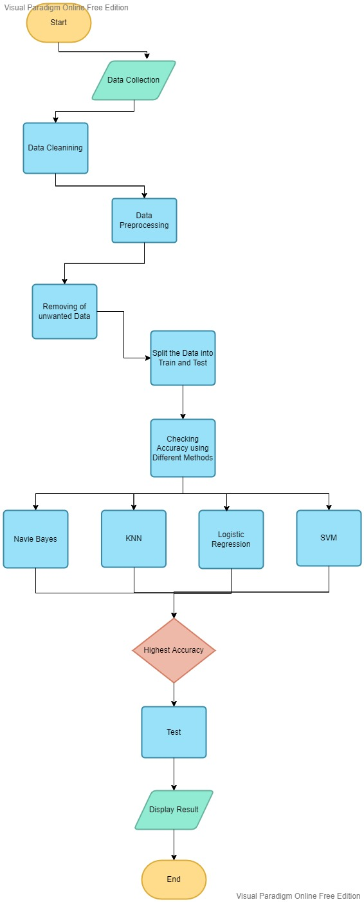
Flow Diagram
Proposed Methodology

Slide 5
Experimental Results
Random Forest Depth Accuracy and Test Report
 | precision | recall | f1-score
Negative=0 | 0.80 | 0.83 | 0.82
Positive=1 | 0.66 | 0.60 | 0.63

Slide 6
Accuracy of Models
 | Random Forest | Multinomial NB | Naive Bayes | Support Vector Machine | Logistic Regression | KNN | Perceptron
Accuracy | 0.7535 | 0.7815 | 0.7198 | 0.7759 | 0.6526 | 0.6526 | 0.7507

Slide 7
Depth Accuracy and Test Report of KNN and MUltinomialNB
Findings of the Project
We have found the MultinomialNB gives the best accuracy when compared to KNN. So, we want to improve the MultinomialNB Accuracy and gives the best results.
 | precision | recall | f1-score
Negative=0 | 0.65 | 1.00 | 0.79
Positive=1 | 0.52 | 0.67 | 0.45
 | precision | recall | f1-score
Negative=0 | 0.82 | 0.86 | 0.84
Positive=1 | 0.71 | 0.64 | 0.67

Slide 8





WHAT WE ARE WORKING ON

Slide 9
Conclusion
By comparison of all the models we achieved the maximum accuracy with the naïve bayes and MultinomialNB model our project’s main goal is to create a safe space where reviews can be shared, we review the reviews for you so that you can concentrate on good part , mental health aspect is our main concern while building the model our target is vulgar behaviour.
Our future extension of this project includes creating a whole website for our university purpose where teachers can get real time feedback with scores based on polarity of texts simple, straightforward and to point.

Slide 10
REFERENCES
[1] S. Rani and P. Kumar, "A Sentiment Analysis System to Improve Teaching and Learning," in Computer, vol. 50, no. 5, pp. 36-43, May 2017, Doi: 10.1109/MC.2017.133.\\
[2] K. L. S. Kumar, J. Desai and J. Majumdar, "Opinion mining and sentiment analysis on online customer review," 2016 IEEE International Conference on Computational Intelligence and Computing Research (ICCIC), 2016, pp. 1-4, doi: 10.1109/ICCIC.2016.7919584. \\
[3]D. Zimbra, M. Ghiassi and S. Lee, "Brand-Related Twitter Sentiment Analysis Using Feature Engineering and the Dynamic Architecture for Artificial Neural Networks," 2016 49th Hawaii International Conference on System Sciences (HICSS), 2016, pp. 1930-1938, Doi: 10.1109/HICSS.2016.244.\\
[4] M. H. Abd El-Jawad, R. Hodhod and Y. M. K. Omar, "Sentiment Analysis of Social Media Networks Using Machine Learning," 2018 14th International Computer Engineering Conference (ICENCO), 2018, pp. 174-176, doi: 10.1109/ICENCO.2018.8636124.\\
Available from:{https://link.springer.com/chapter/10.1007/978-3-030-61702-8_23 }
https://towardsdatascience.com/sentiment-analysis-concept-analysis-and-applications-6c94d6f58c17

Slide 11


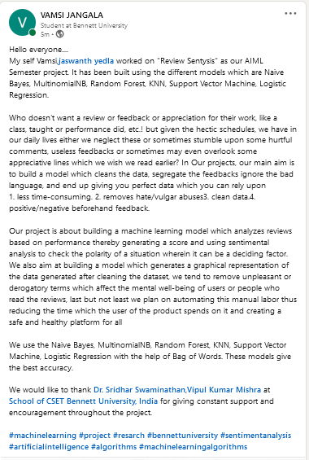


Social Media Post

Slide 12

Thank You

